Slide 1
Steps to apply for passport

Slide 2
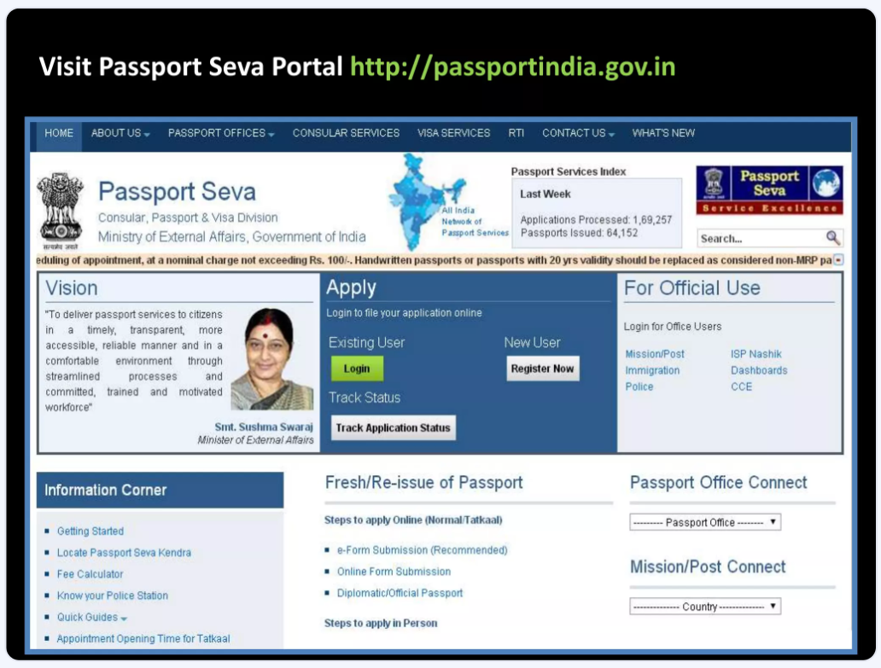

Slide 3
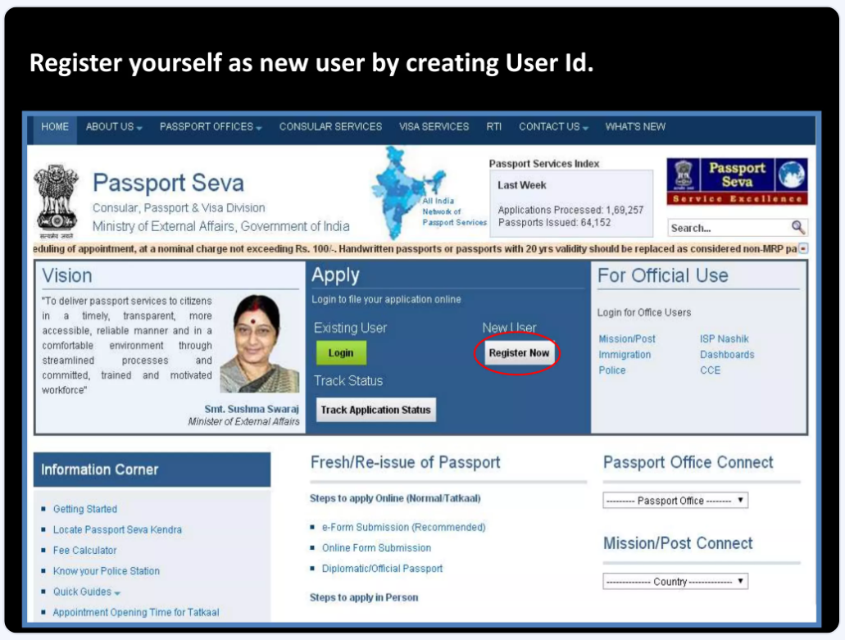

Slide 4
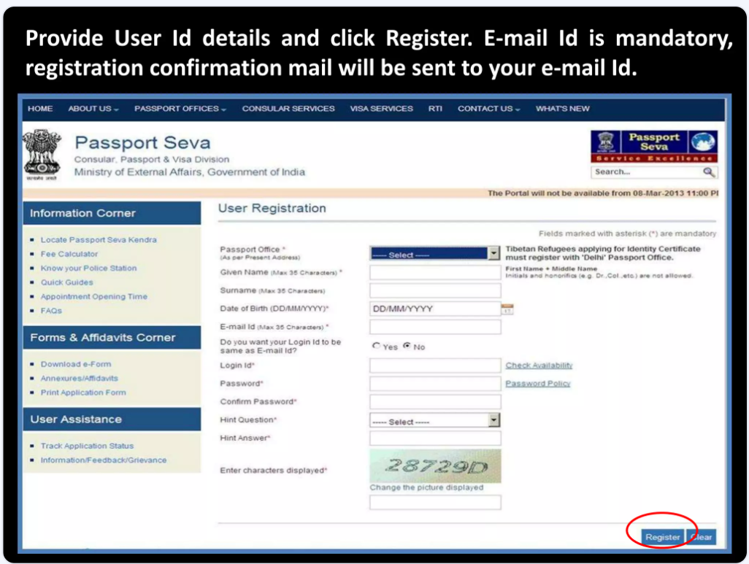

Slide 5
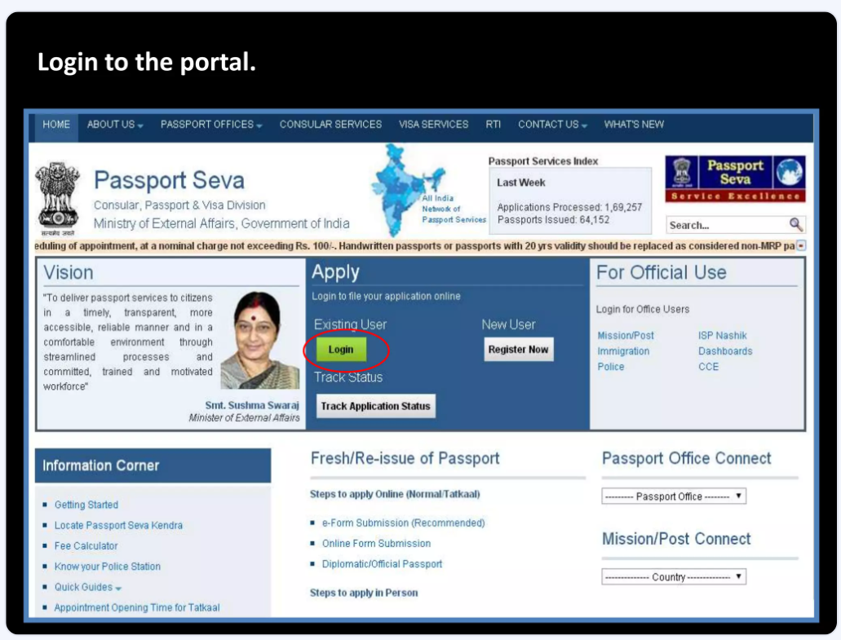

Slide 6
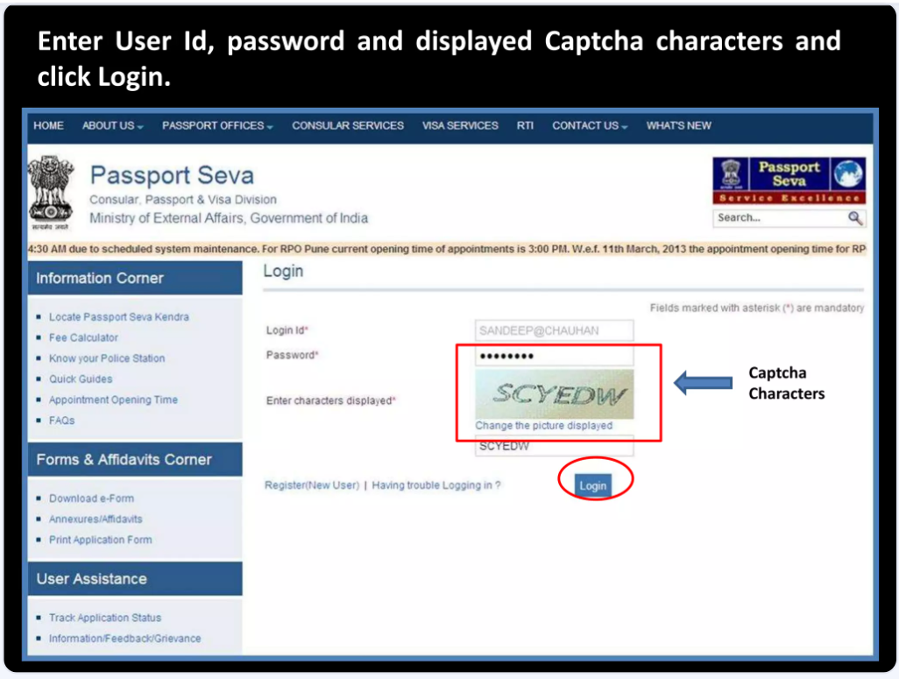

Slide 7
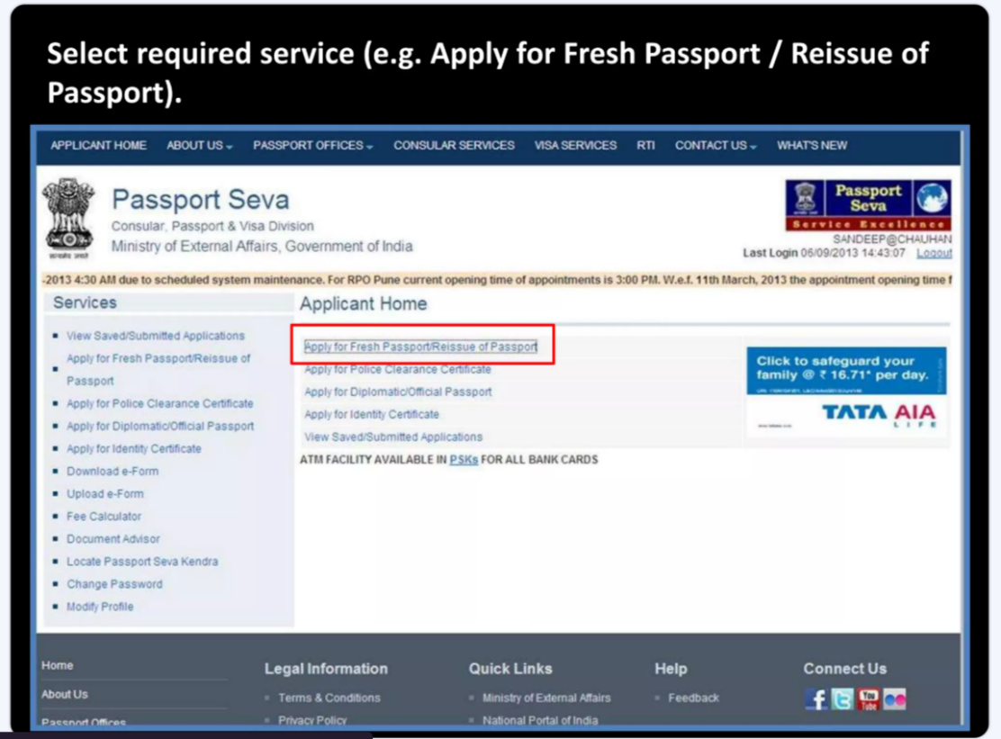

Slide 8
You can apply for passport /reissue passport through two methods :
Alternate 1:- Downloading E- Form And Uploading Later
Alternate 2:- Filling application form online

Slide 9
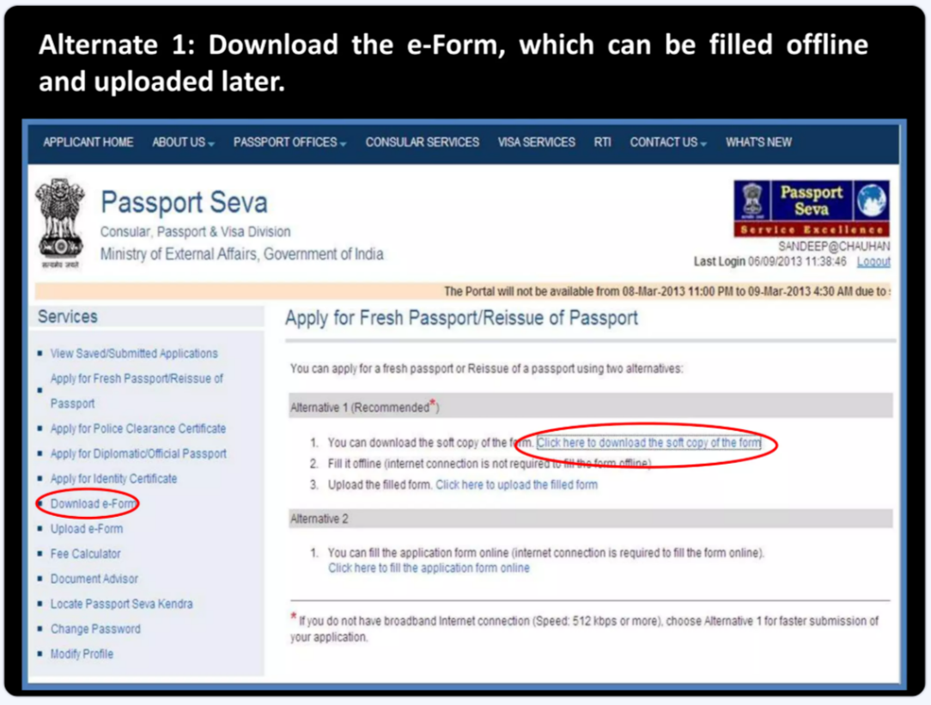

Slide 10
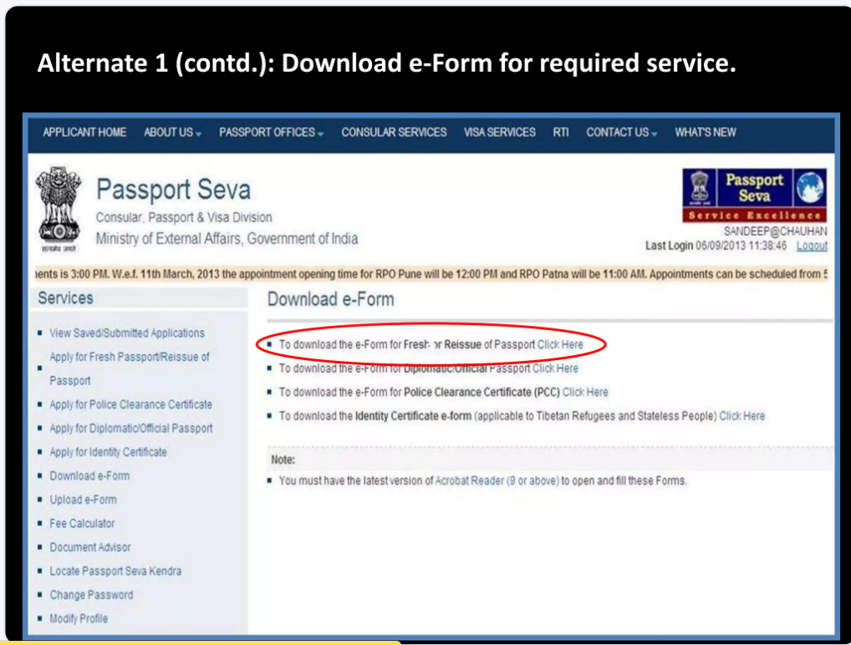

Slide 11
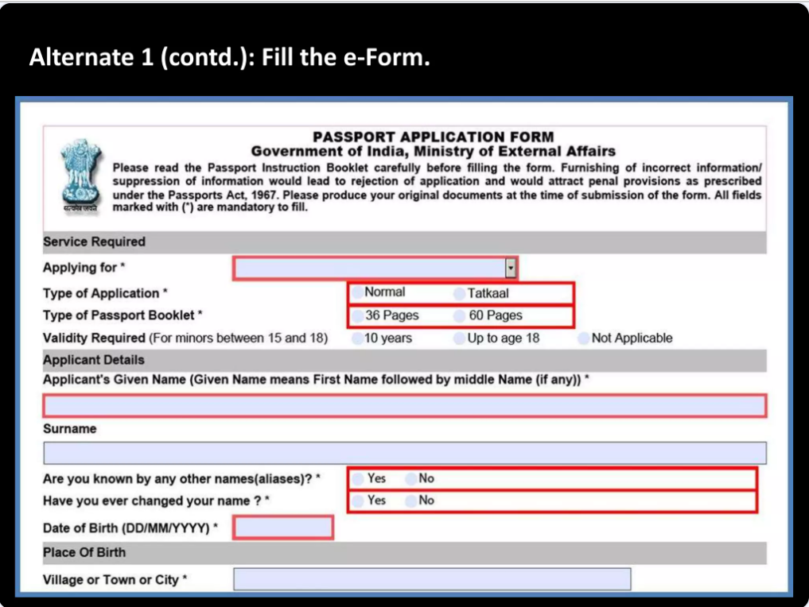

Slide 12
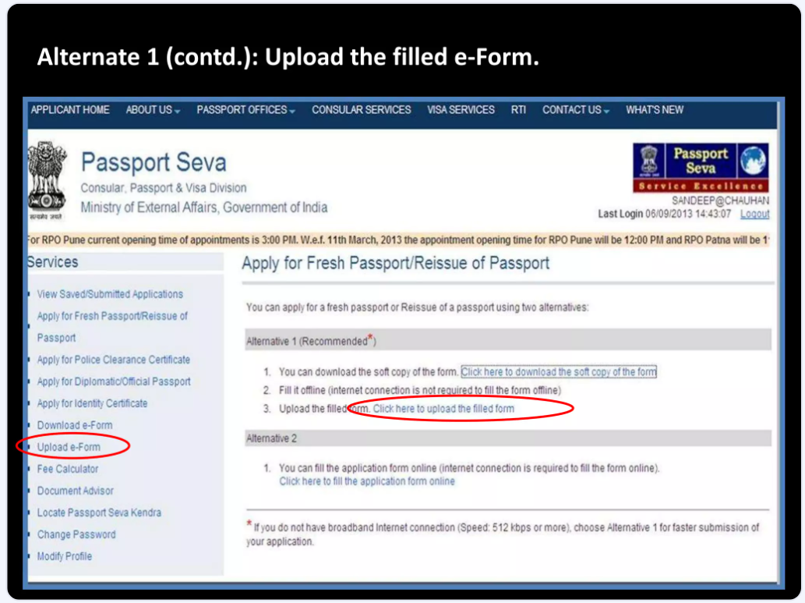

Slide 13
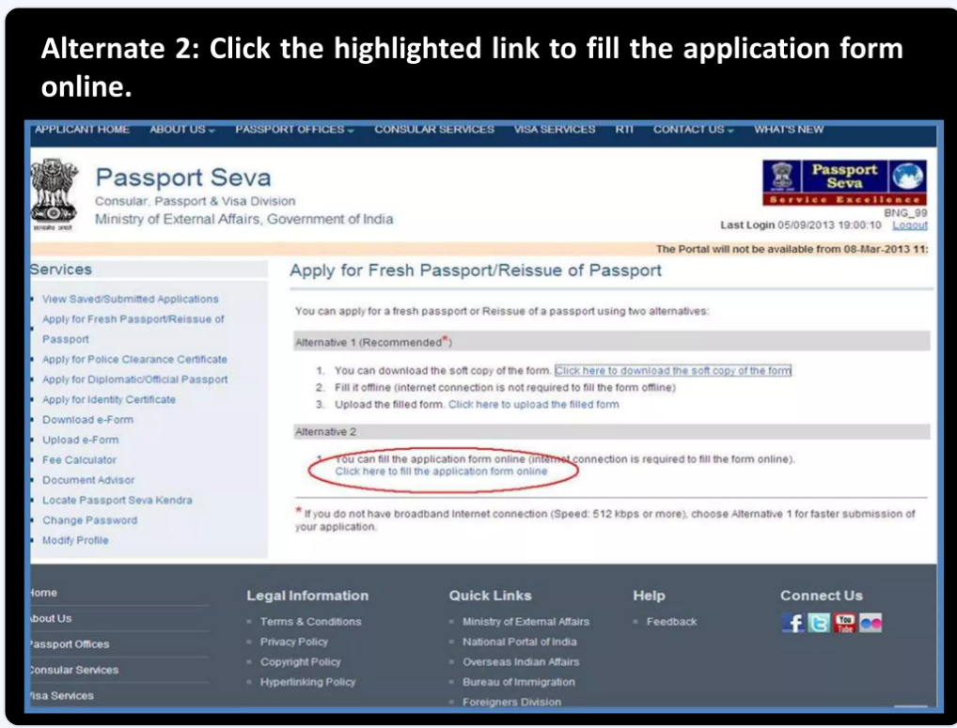

Slide 14
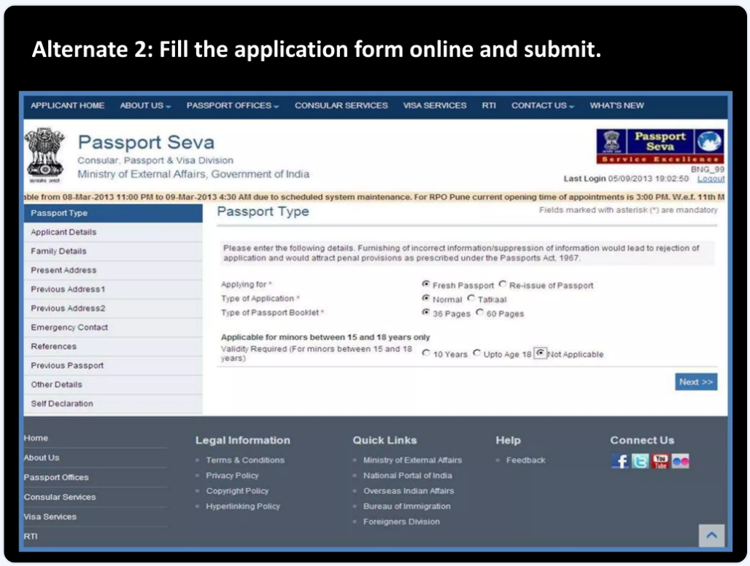

Slide 15
Schedule appointment
PSKs for which online payment is mandatory for booking appointments.
Access the URL:www.passportindia.gov.in for list of these PSKs

Slide 16
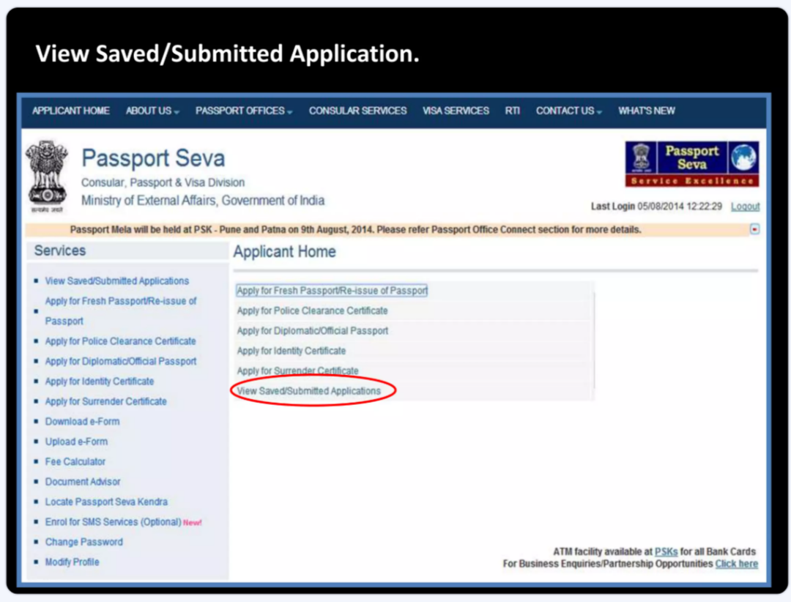

Slide 17
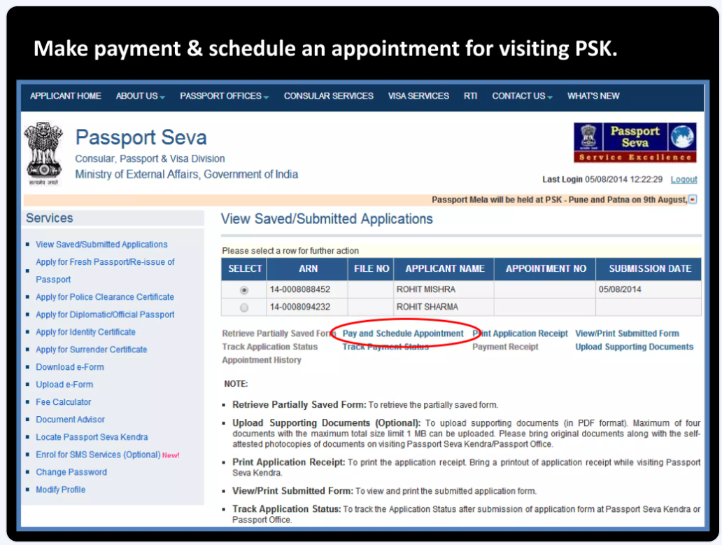

Slide 18
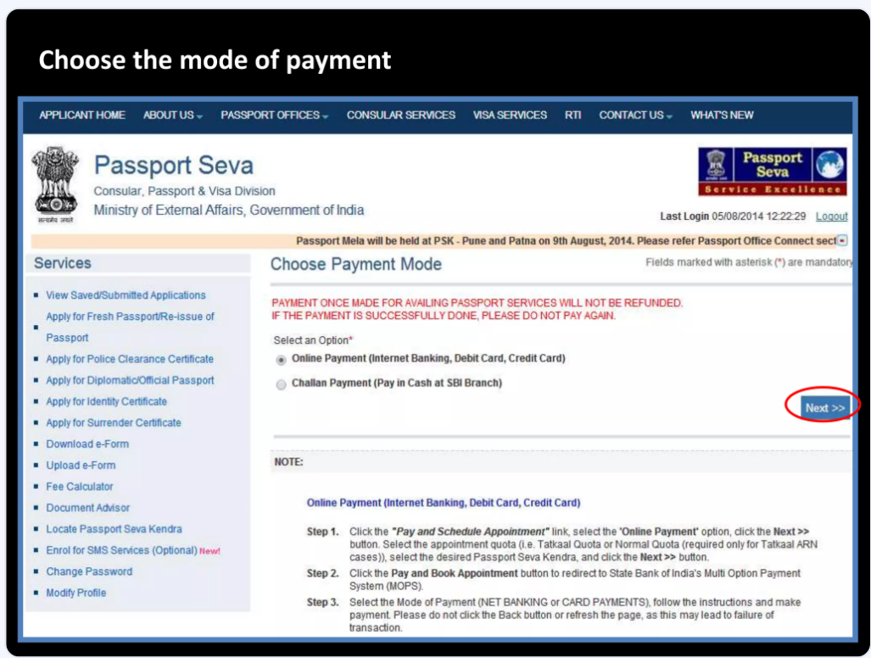

Slide 19
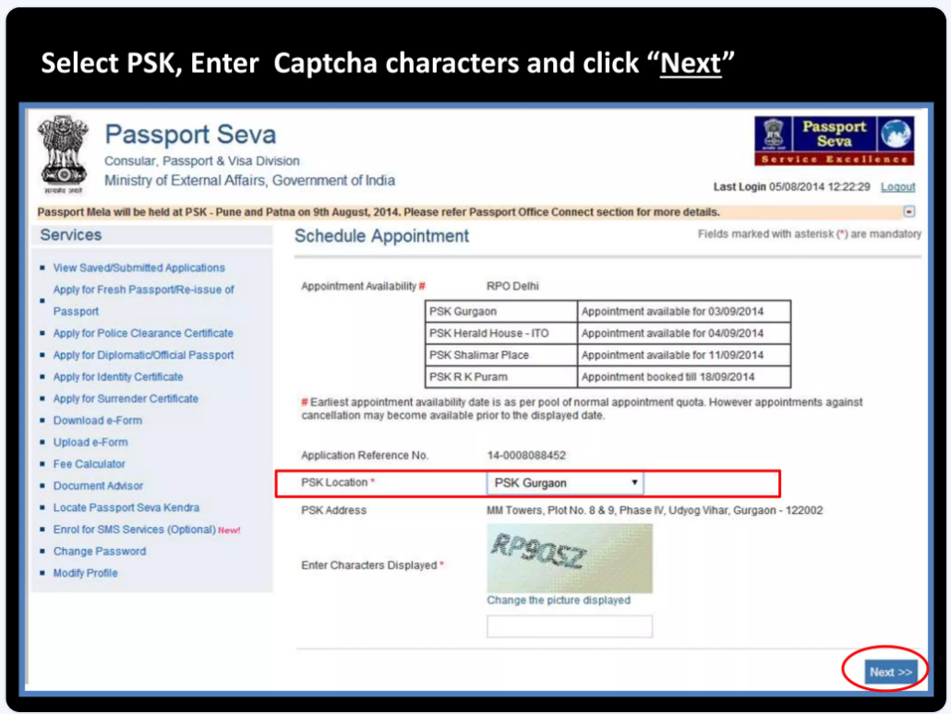

Slide 20
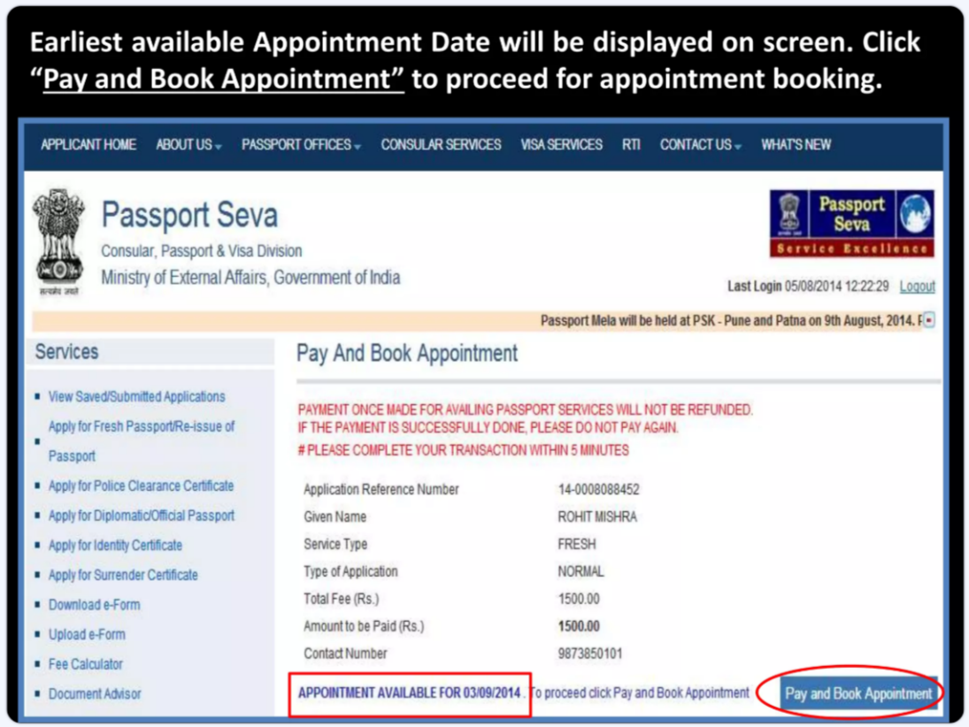

Slide 21
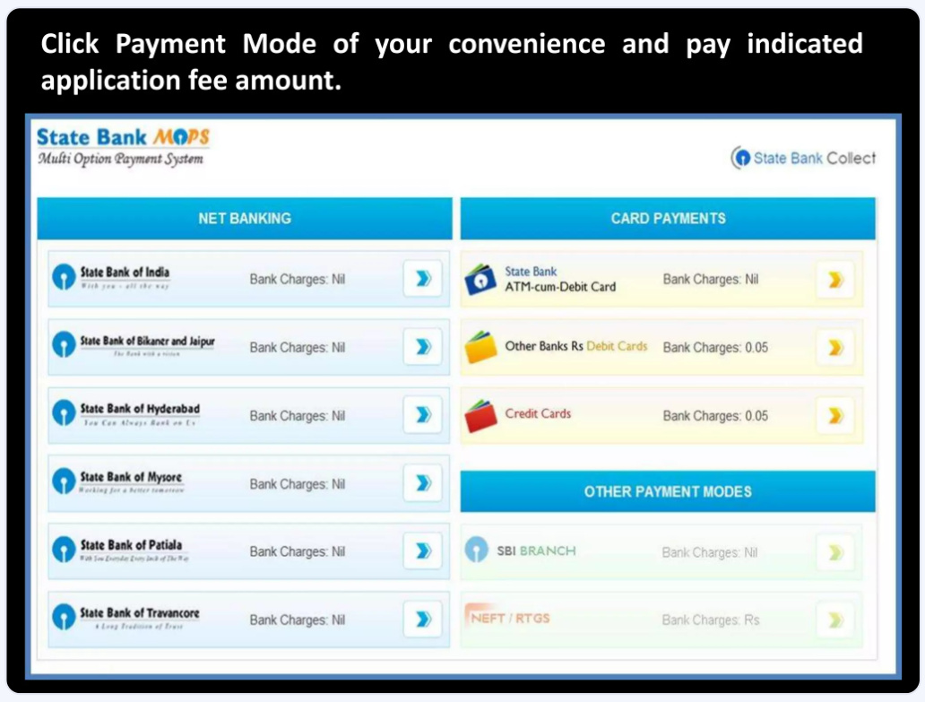

Slide 22
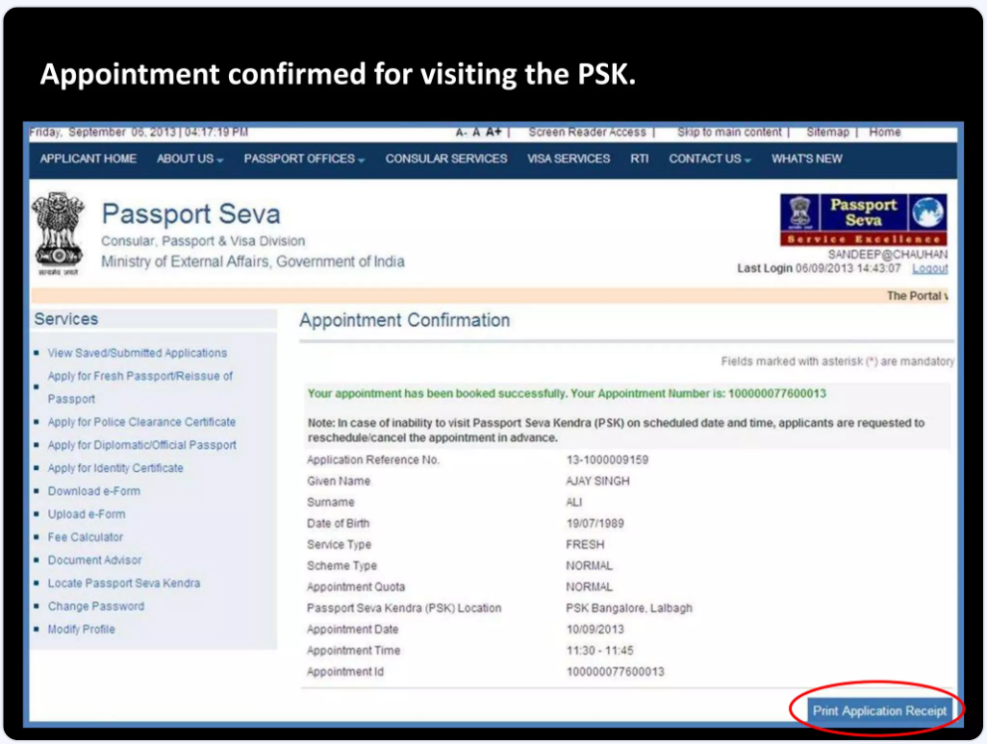

Slide 23
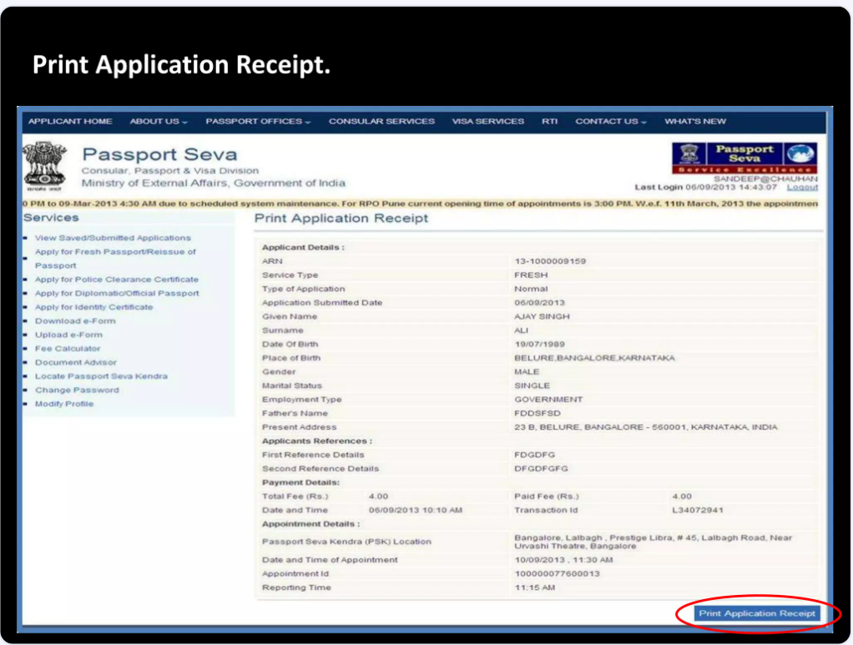

Slide 24
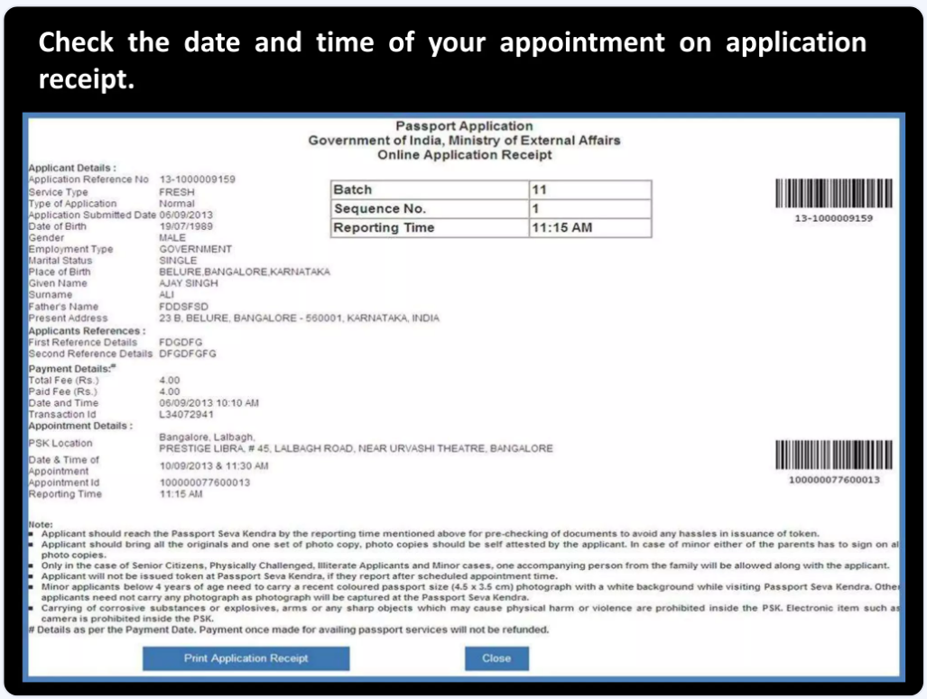

Slide 25
In Case Additional Information Or Clarification ,Please Contact Our National Call Centre At Toll Free Number 1800-258-1800

Slide 26
Thank you

